Slide 1

Machine Learning for Cyber Security
Week 5
Mesut GUVEN, Ph.D.

Slide 2
information
Exams; 55% (Mid 25% + Final 30%), Homeworks; 15%, Project; 30%
In homeworks, you will be expected to examine SCI/E papers (published in last 3 years).
In Final Project, you will implement an AI/ML-based cyber solution.
Textbook:
- Getting Started with Deep Learning: Programming and Methodologies using Python
- Hands-On Machine Learning with Scikit-Learn, Keras, and TensorFlow, 2nd Edition
Code: GitHub
Videos: YouTube

Slide 3
UNIT 5: ANN, Deep learning
Learning Outcomes;
- have a better understanding of ANNs,
- have a better understanding of Deep Learning,

Slide 4
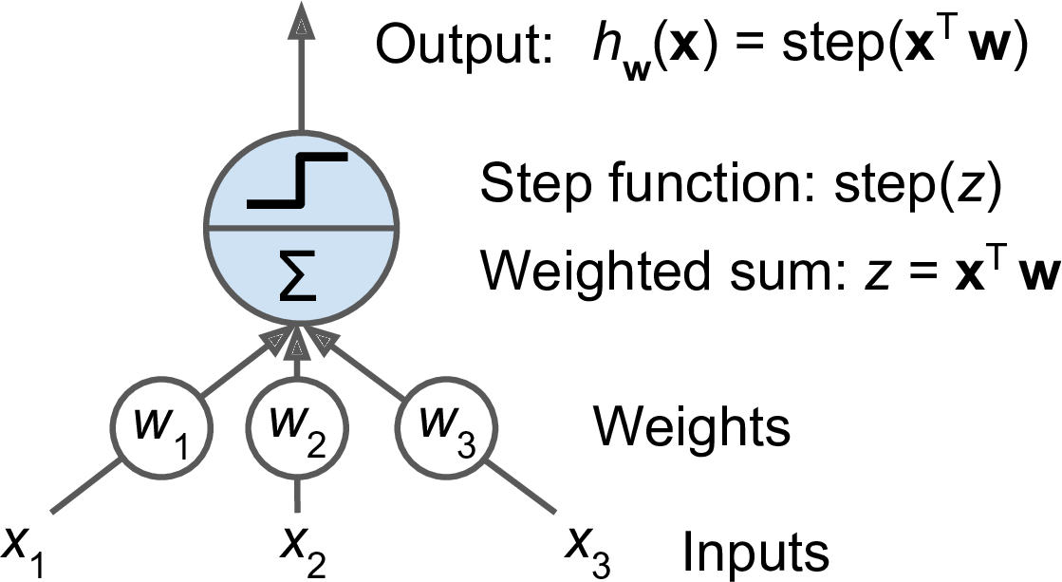
Artificial neural networks
The brain’s architecture is the key idea that sparked Artificial Neural Networks (ANNs). And ANNs are at the very core of Deep Learning.
ANNs are versatile, powerful, and scalable, making them ideal to tackle large and highly complex Machine Learning tasks, such as;
- Classifying billions of images (e.g., Google Images),
- Speech recognition services (e.g., Apple’s Siri),
- Recommending services (video recommending, e.g., YouTube)
- Playing games (Go Games, DeepMind’s Alpha‐Zero), etc.

Slide 5
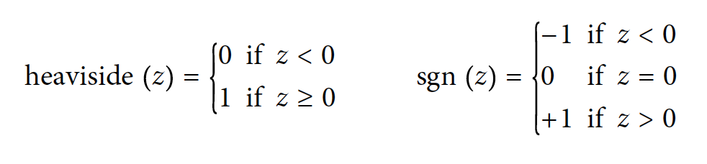
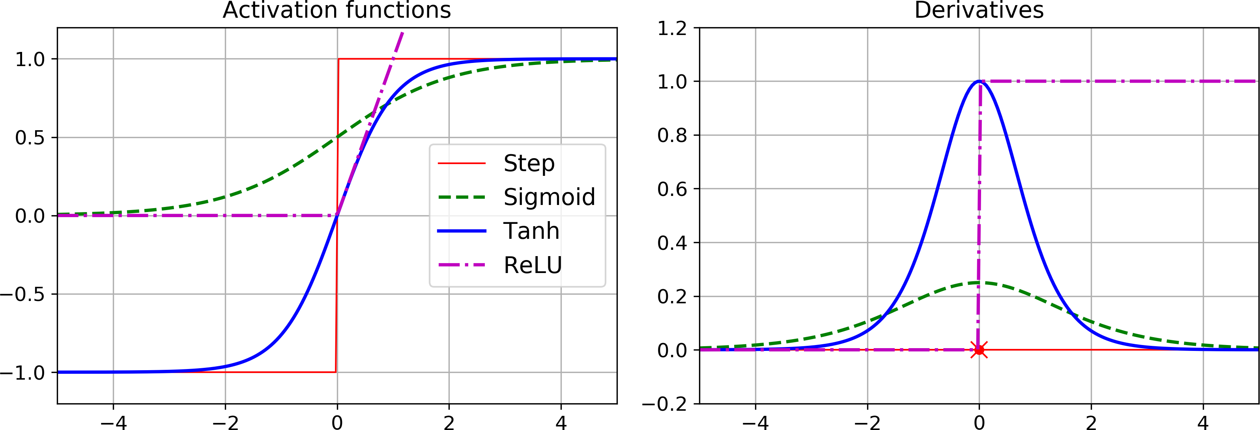
Artificial neural networks
ANNs are based on a single perceptron unit. Perceptrons use the Treshold Logic Unit. The TLU computes a weighted sum of its inputs;
(z = w1 x1 + w2 x2 + ⋯ + wn xn = xT w),
then applies a step function to that sum and outputs the result. If it is a linear unit, it produces either “0” or “1”.
For a very long time, it was believed that perceptron-based networks can only solve linear problems just like a logistic regression classifier or linear support vector machines.
But, in 1987, it was corrected that with the help multi-layer perceptrons and activation functions such as sigmoid, exponential linear unit, etc. artificial neural networks can be used for non-linear problems.

Slide 6
Artificial neural networks
If all the neurons in a layer are connected to every neuron in the previous layer (i.e., its input neurons), it is called a fully connected layer or a dense layer.
ANNs structure consist of three parts, respectively; Input Layer, Hidden Layer(s), and Output Layer.
The dataset are handled one mini-batch at a time (ex. 32 samples in one epoch). Inputs are multiplied by weights, then it passes to next layers and computation propagate to forward for prediction (forward pass).
Next, network’s output error is measured by comparing the predictions with desired outputs. Error contribution of each layer and connection is measured and weights are tuned to backward, this is called backpropagation (reverse automatic differentiation-autodiff).
Input Layer
Hidden Layers
Output Layer

Slide 7
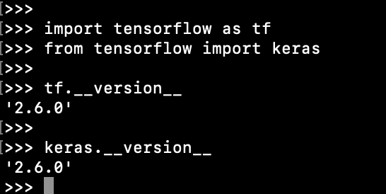
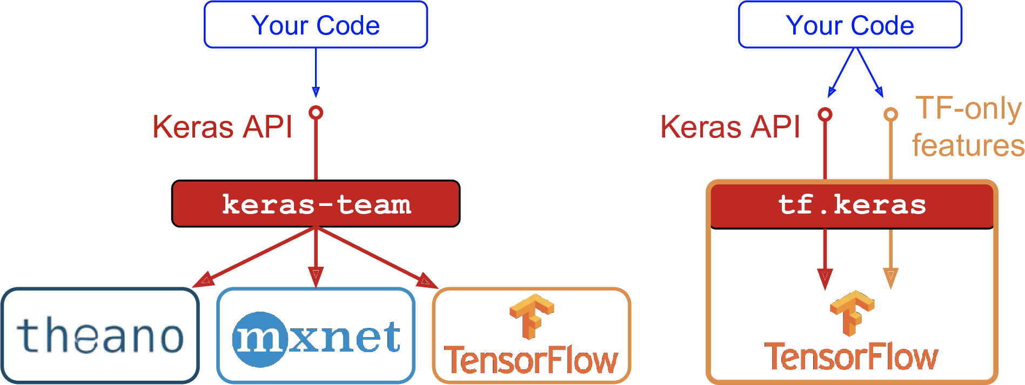
Implementing ANN/DL with keras
The term Deep Learning (DL) is used for ANNs with hidden layers of two or more. This a traditional definition and today’s deep learning networks have dozens or hundreds of hidden layers thanks to computational power we have.
Keras is a high-level Deep Learning API that allows to build train, evaluate and execute all sorts of neural networks. Tensorflow has Keras on itself.
NOTE: You can install Tensorflow2 by typing
$ python3 -m pip install --upgrade tensorflow

Slide 8
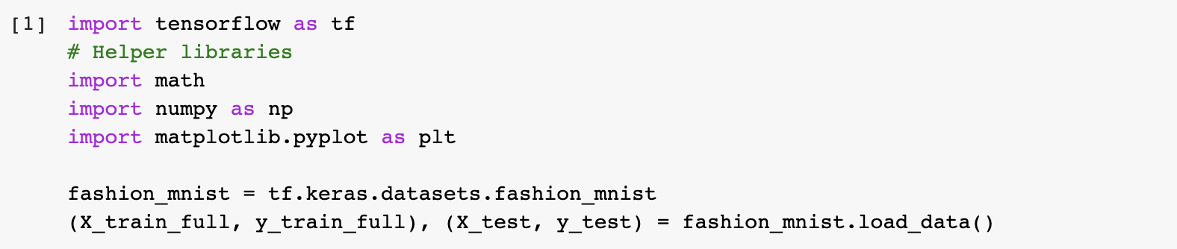
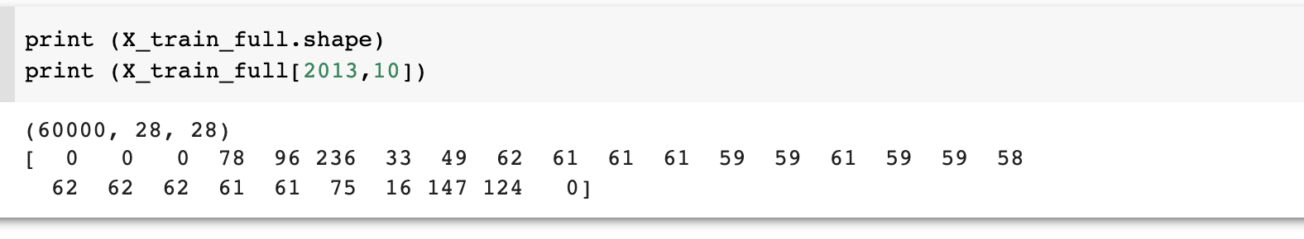
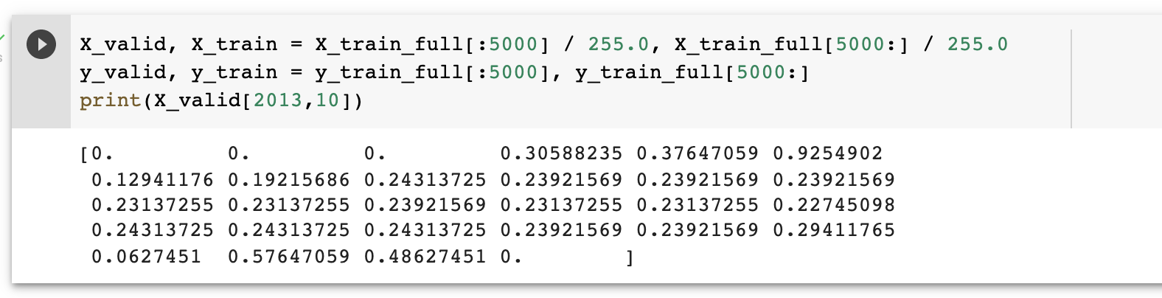
Building a classifier
The MNIST is an image dataset consisting 70,000 grayscale images of 28x28 pixels. Keras provides some utility functions to fetch and load MNIST dataset.
Unlike Scikit-learn, Keras loads images as 2D array and pixels represented with integers range between [0-255].
Take first 5000 samples for training and save the 5000th to 6000th for validation.
Convert pixel values to double and scale them between range [0.00-1.00].

Slide 9
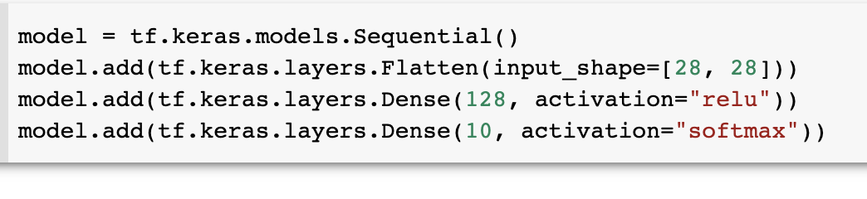
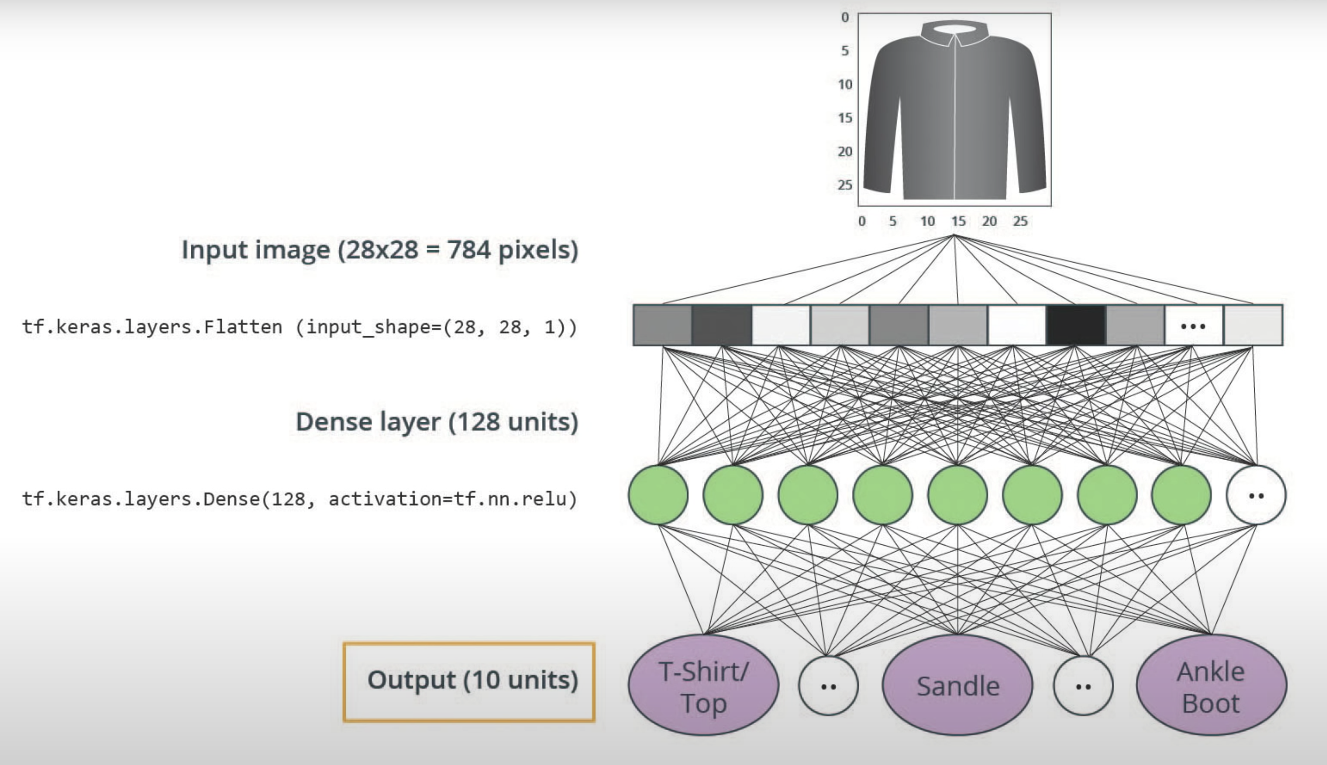
Building a classifier: MLP

Slide 10
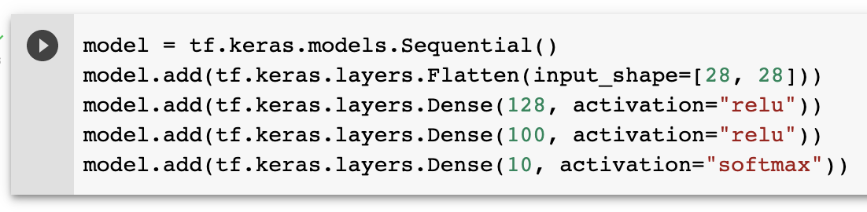
Building a classifier: MLP
The first line creates a Sequential model; the simplest form of Keras model composed of a single stack of layers which are connected sequentially.
Second line; Remember Keras loads the MNIST samples as 2D arrays, but neural networks accepts 1D inputs. So, first process is to flatten the image samples. 28x28 2D array converted to 784x1 1D array.
Next a Dense hidden layer with 128 neurons is added, it uses the ReLU activation function. Each neurons have their weight matrices and bias terms. The output computation of each neurons than passes to the next dense layer of 100 neurons.
Finally, a dense layer of 10 neurons (for each class) with softmax activation function (produces a probability distribution ranging between 0 and 1)

Slide 11
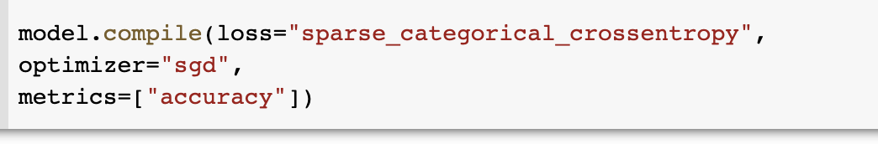
Building a classifier: MLP
Once the model is created, some parameters are added during the compile step.
Loss function — An algorithm for measuring how far the model's outputs are from the desired output. The goal of training is this measures loss. we use the "sparse_categorical_cross entropy" loss because we have sparse labels.
Optimizer —An algorithm for adjusting the inner parameters of the model in order to minimize loss. regarding the optimizer, "sgd" simply means that we will train the model using simple Stochastic Gradient Descent (back propagation algorithm).
Metrics —Used to monitor the training and testing steps. Accuracy is used during the training and evaluation.

Slide 12
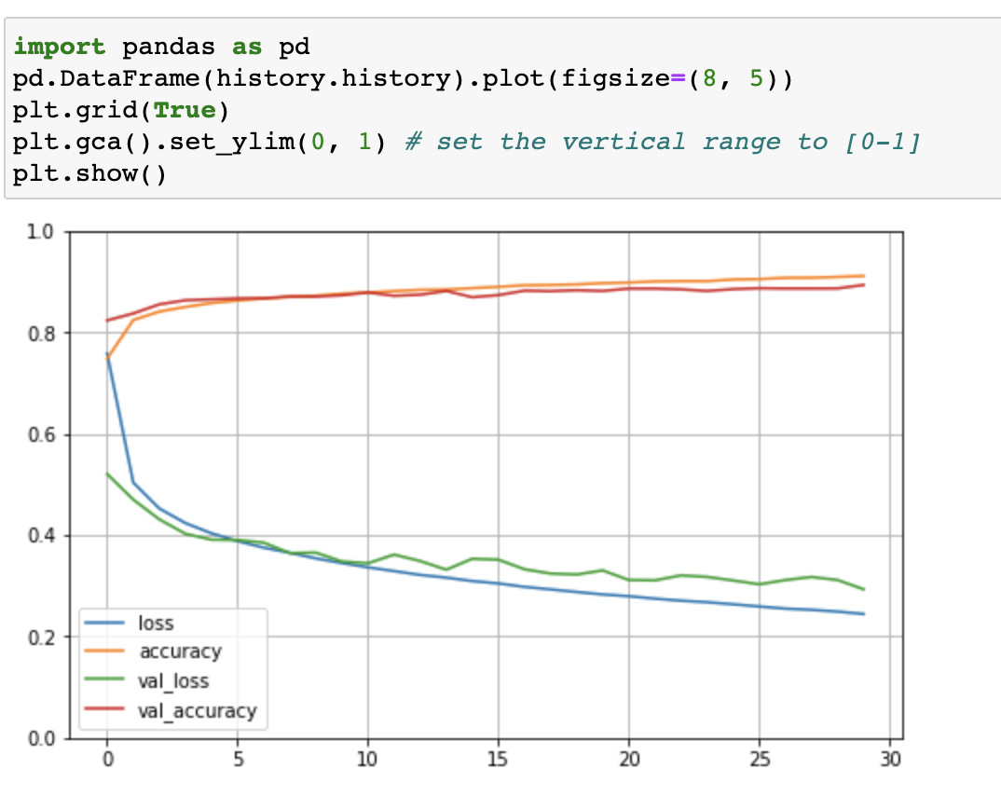
Building a classifier: MLP
The fit() method returns a History object containing the training parameters (history.params), the list of epochs it went through (history.epoch), and most importantly a dictionary (history.history) containing the loss and extra metrics it measured at the end of each epoch on the training set and on the validation set.

Slide 13
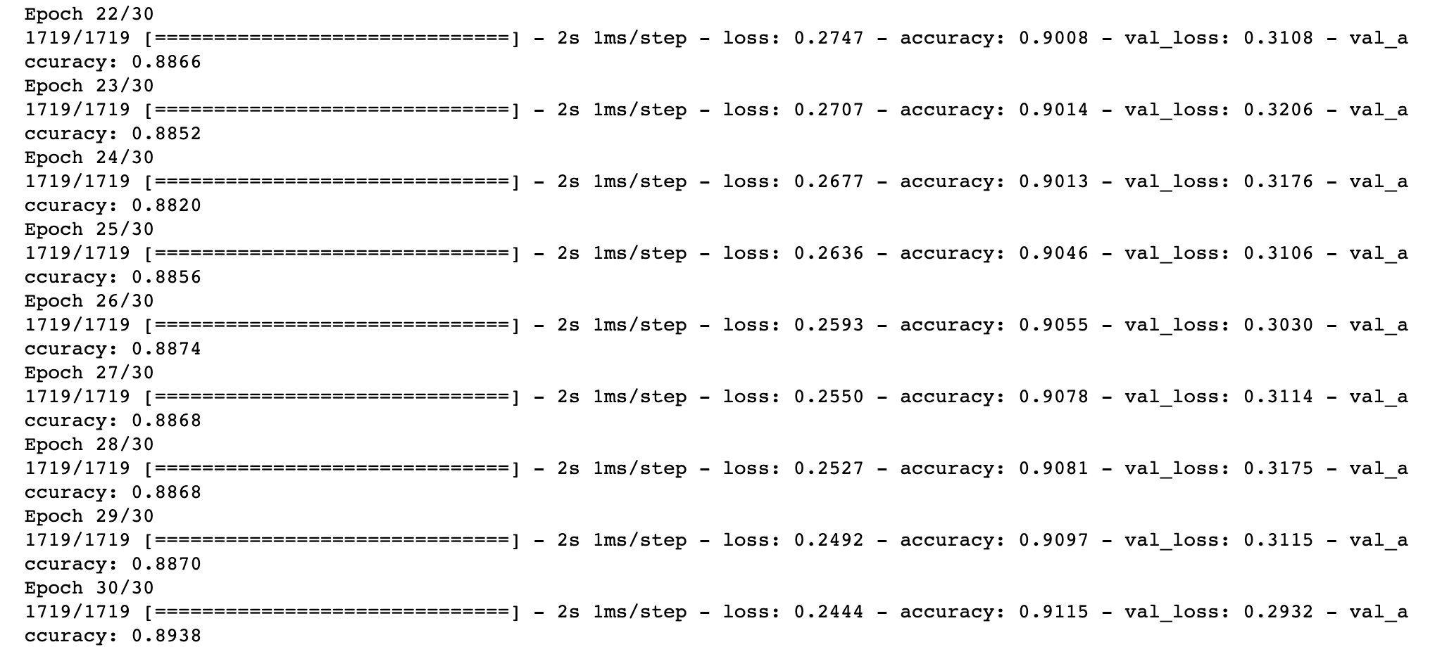
Building a classifier: MLP
Validation set is used to mitigate the overfitting. In the 30th epoch the validation accuracy steadily increasing, but somewhere between 30th to 40th epochs, training accuracy stops beating validation accuracy. So, this the point to stop for the best weights and biases.

Slide 14
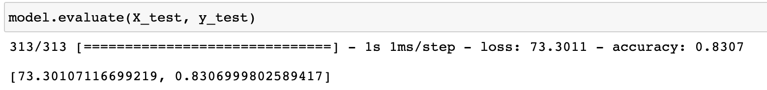
Building a classifier: MLP
Once you are satisfied with your model’s validation accuracy, you should evaluate it on the test set to estimate the generalization error before you deploy the model to production. You can easily do this using the evaluate() method

Slide 15
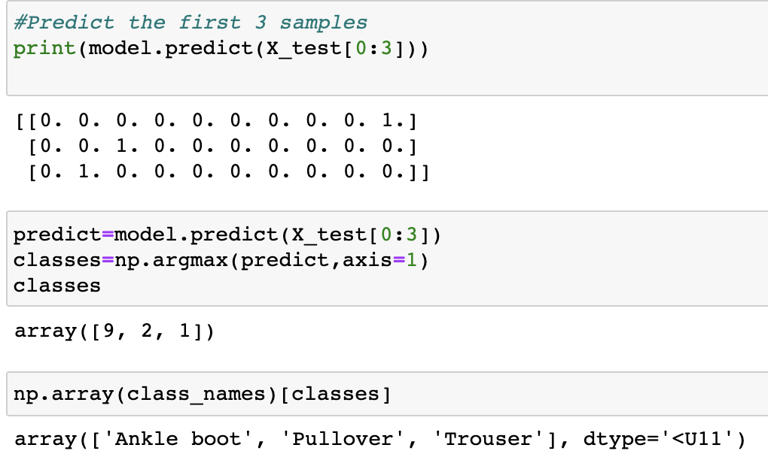
Building a classifier: MLP
With predict() method, you can make predictions. The outcome is a probability for each class.
Then, class probabilities can be translated to class labels.
Now, we can build, train, and evaluate an MLP by using the Sequential API.

